Slide 1






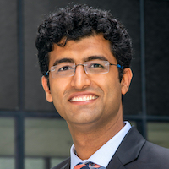


Neural Motion Fields: Encoding Grasp Trajectories as Implicit Value Functions
Yun-Chun Chen
Adithya Murali
Balakumar Sundaralingam
Wei Yang
Animesh Garg
Dieter Fox

Slide 2
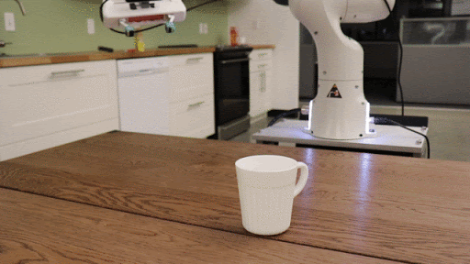
Existing Grasping Methods
Grasp pose detection
Find inverse kinematic solutions
Plan a collision-free trajectory
Execute the open-loop trajectory
6-DOF GraspNet: Variational Grasp Generation for Object Manipulation. In ICCV, 2019.

Slide 3
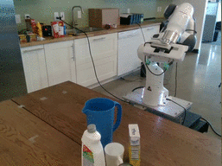
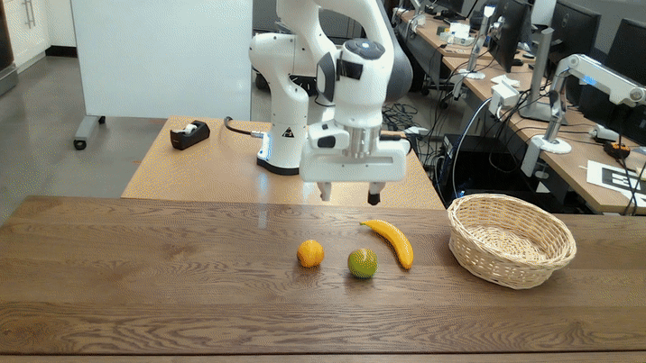
Existing Grasping Methods
+ Table-top object grasping
+ Grasping in clutter
+ Bin-picking
- Infer a finite discrete number of grasps
Grasp affordances are a continuous manifold
Contact-GraspNet: Efficient 6-DOF Grasp Generation in Cluttered Scenes. In ICRA, 2021.
6-DOF Grasping for Target-driven Object Manipulation in Clutter. In ICRA, 2020.
6-DOF GraspNet: Variational Grasp Generation for Object Manipulation. In ICCV, 2019.

Slide 4
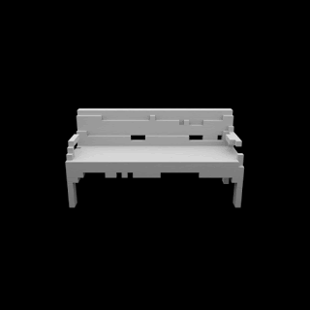
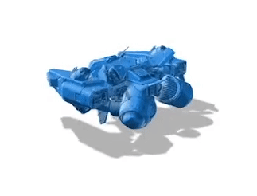
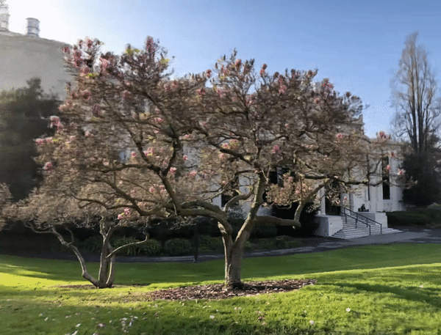
Implicit Representations in Visual Computing
Shape reconstruction
Rendering
Novel view synthesis
Occupancy Networks: Learning 3D Reconstruction in Function Space. In CVPR, 2019.
Neural Geometric Level of Detail: Real-time Rendering with Implicit 3D Shapes. In CVPR, 2021.
NeRF: Representing Scenes as Neural Radance Fields for View Synthesis. In ECCV, 2020.

Slide 5
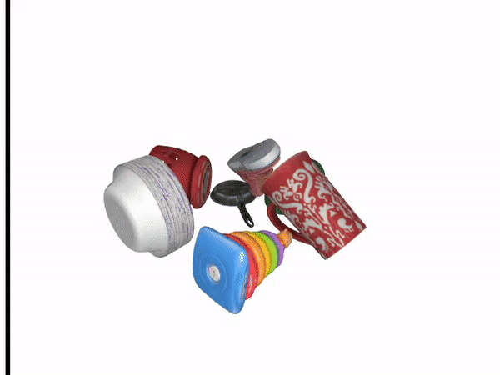
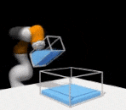
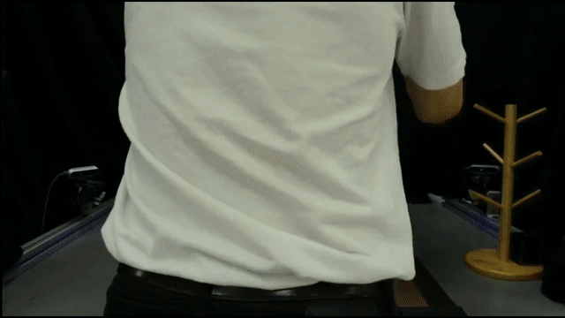
Implicit Neural Representations in Robotics
Grasp detection
Visuomotor control
Manipulation
Synergies Between Affordance and Geometry: 6-DOF Grasp Detection via Implicit Representations. In RSS, 2021.
3D Neural Scene Representations for Visuomotor Control. In CoRL, 2021.
Neural Descriptor Fields: SE(3)-Equivariant Object Representations for Manipulation. In ICRA, 2022.

Slide 6
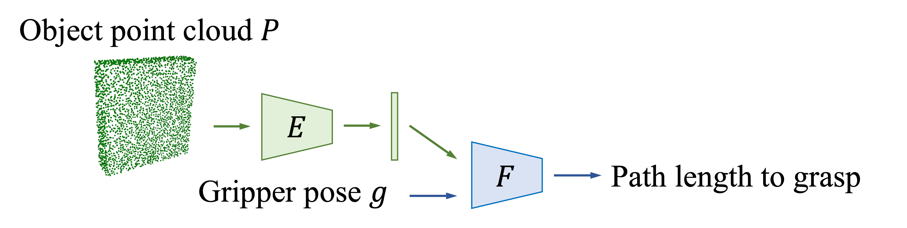
Neural Motion Fields
Goal:
Learn a value function that can be used to plan a trajectory for grasping
Value function:
Map a gripper pose to its path length to a grasp
Gripper pose path length:

Slide 7
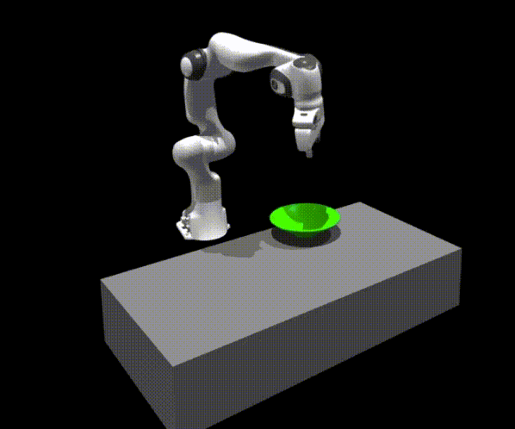
Grasp Motion Generation
Query gripper poses and optimize the value function using a sampling-based MPC framework (MPPI)
STORM: An Integrated Framework for Fast Joint-Space Model-Predictive Control for Reactive Manipulation. In CoRL, 2022.

